Slide 1
Sentiment Analysis
Competing in Best Visualization category
Team Variance
Logan Graham, Austin Brewer, Maya Bowman

Slide 2
How Sentiment Analysis & Polarity Work
TextBlob - Python Library:
Positive or negative rating for each word
Evaluates simple sentence structures
Calculates polarity between 1 and -1 based off of positive or negative sentiment
Limitations:
Struggles with complex sentence structure
Long sentences dilute word pool and tend towards 0

Slide 3
Sentiment Polarity Examples
Positive
“Thank you! This is an awesome service!”
Polarity: 1.0
“This is great info thank you!”
Polarity: 1.0
Negative
“The information you gave is wrong!!!!!”
Polarity: -1.0
“What a worthless website.”
Polarity: -0.80

Slide 4
Polarities
Focus: Family & Children, Housing & Homelessness, and Consumer Finance categories

Slide 5
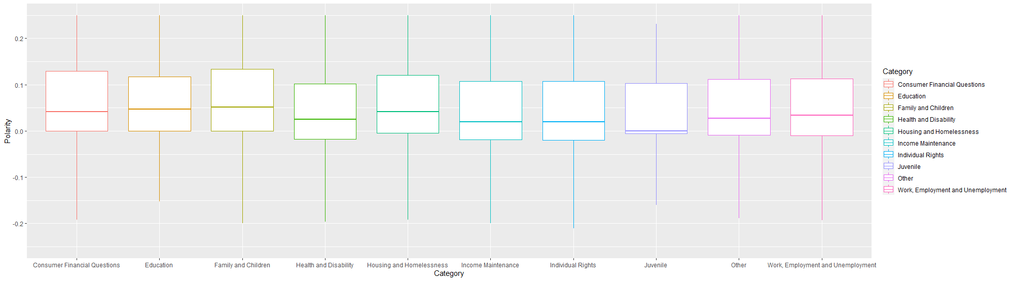
Category Polarities

Slide 6
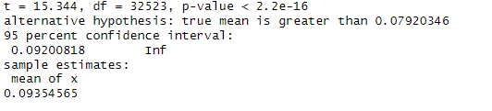
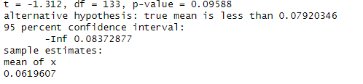
Category: Results
-Family and Children had a statistically significant higher than average polarity.
-Juvenile had a statistically weak lower than average polarity.

Slide 7


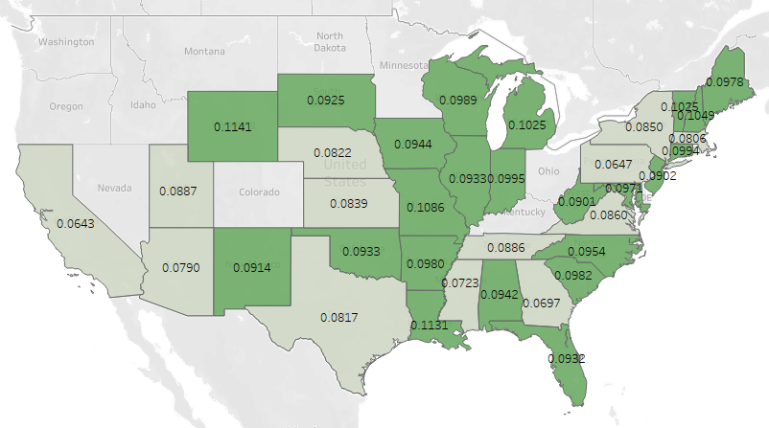
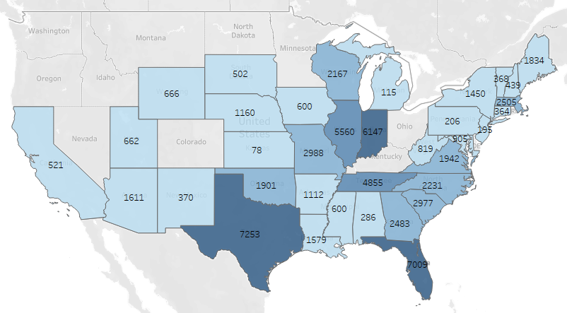
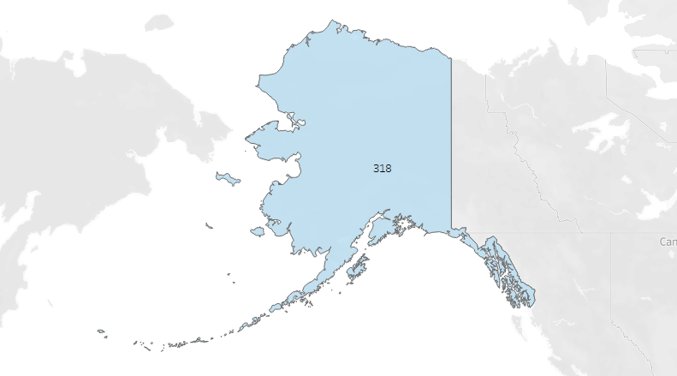
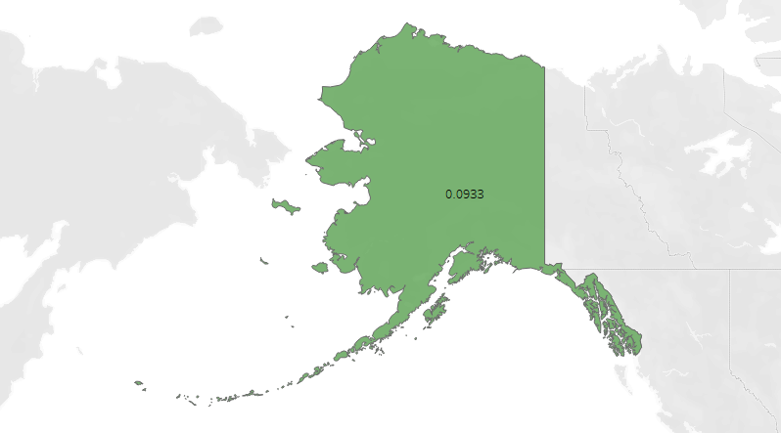
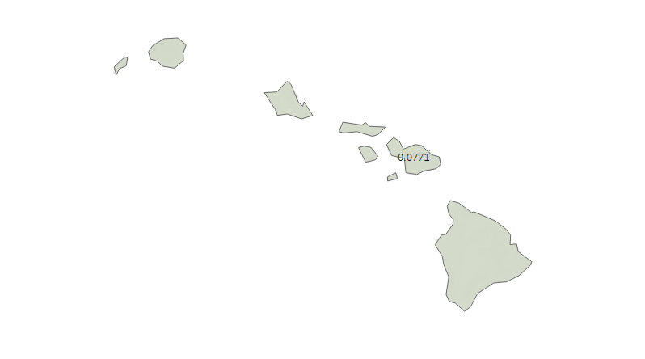
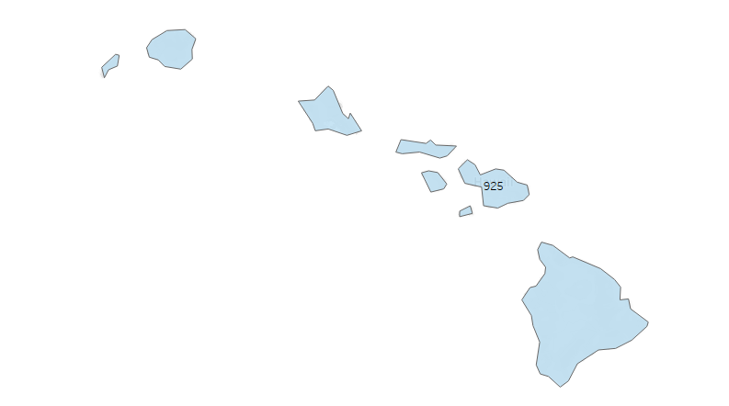
Family & Children
Polarity
Number of Conversations

Slide 8
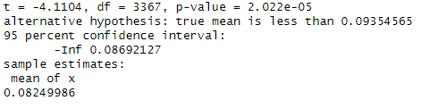
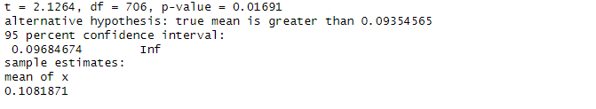
Family & Children: Results
-Texas had a statistically significant lower than average conversation polarity.
-Louisiana had a statistically significant higher than average conversation polarity.

Slide 9
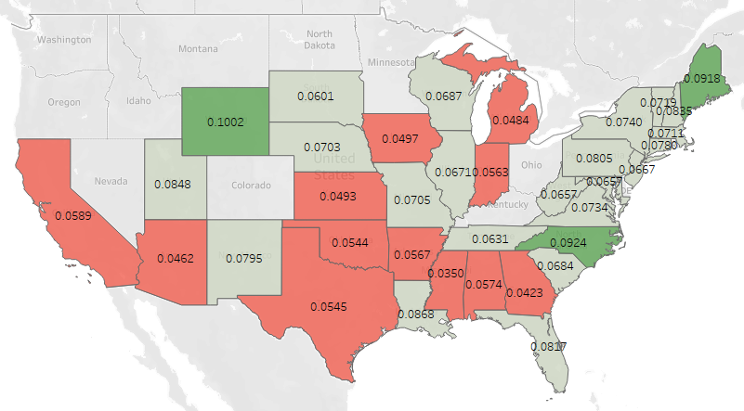
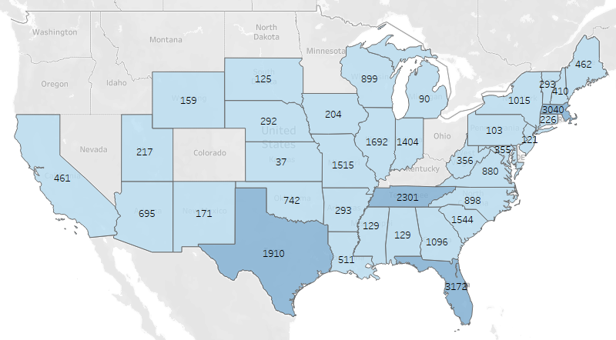
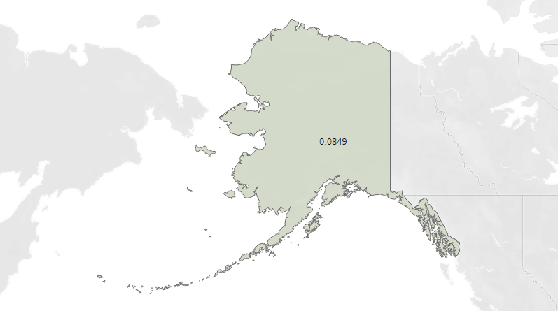

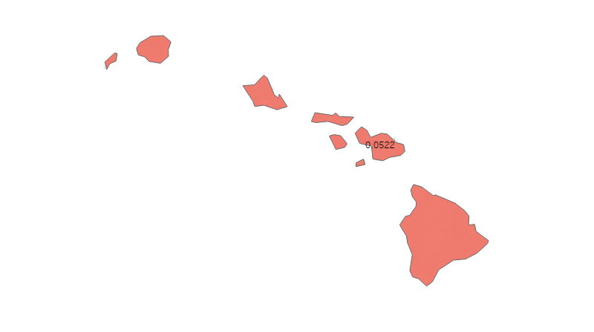
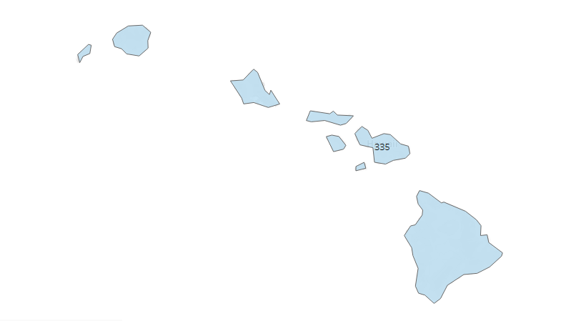
Housing & Homelessness
Polarity
Number of Conversations

Slide 10
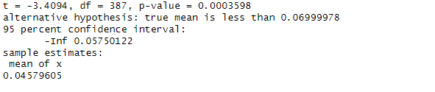
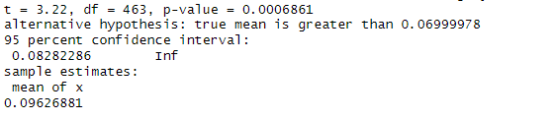
Housing & Homelessness: Results
-Georgia had a statistically significant lower than average conversational polarity.
-North Carolina had a statistically significantly higher than average conversational polarity.

Slide 11
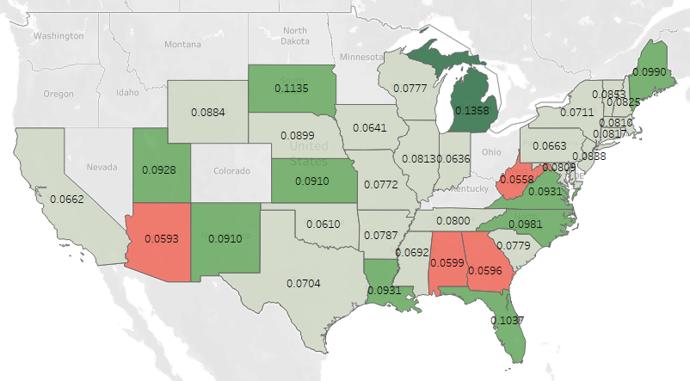
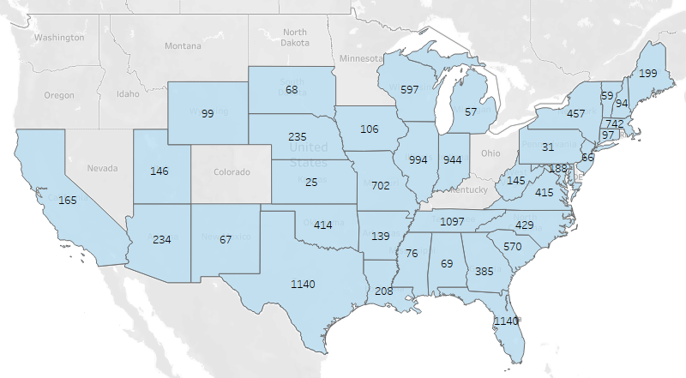
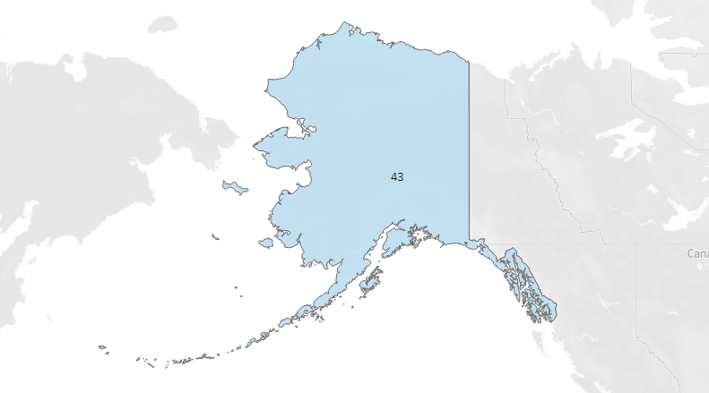


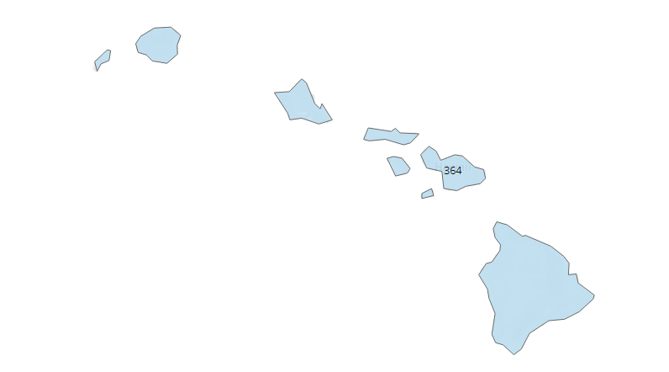
Consumer Finance
Polarity
Number of Conversations

Slide 12
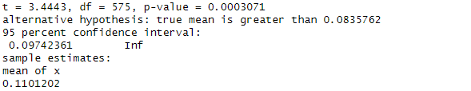
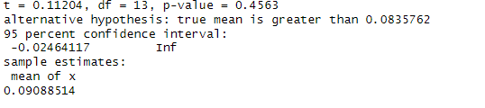
Consumer Finance: Results
-Florida had a statistically significant higher than average conversational polarity.
-Michigan did NOT have a statistically significant higher than average conversational polarity.

Slide 13
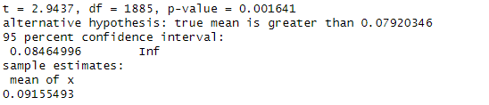
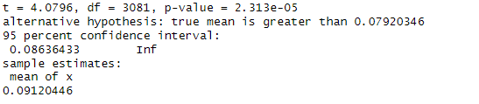
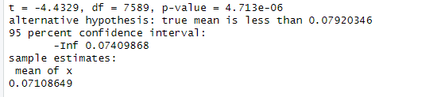
State: Results
ME
When looking at the whole country, Maine and North Carolina both had a statistically significant higher than average conversational polarity.
NC
TX
Texas had a significantly lower than average conversational polarity

Slide 14
Final Thoughts
The clients are more likely to be the ones affecting the positivity or negativity of the conversations
State laws
Cultural differences
Variation in attorney methods
Overall
Family and Children conversations have more positive wording
Maine and North Carolina are having notably more positive conversations than the country average

Slide 15
Thank You!

